Slide 1
Data Analysis Capstone

Slide 2
Introduction:
I have a home safety gun course that I want everyone to buy. I believe the states with the highest rates of mass shootings would be a good place to heavily advertise my course

Slide 3
Data Sources:
The data -Mass Shootings in United States (2018-2022)- came from the website kaggle.com and has no bias in it.
https://www.kaggle.com/datasets/hemil26/mass-shootings-in-united-states-20182022

Slide 4
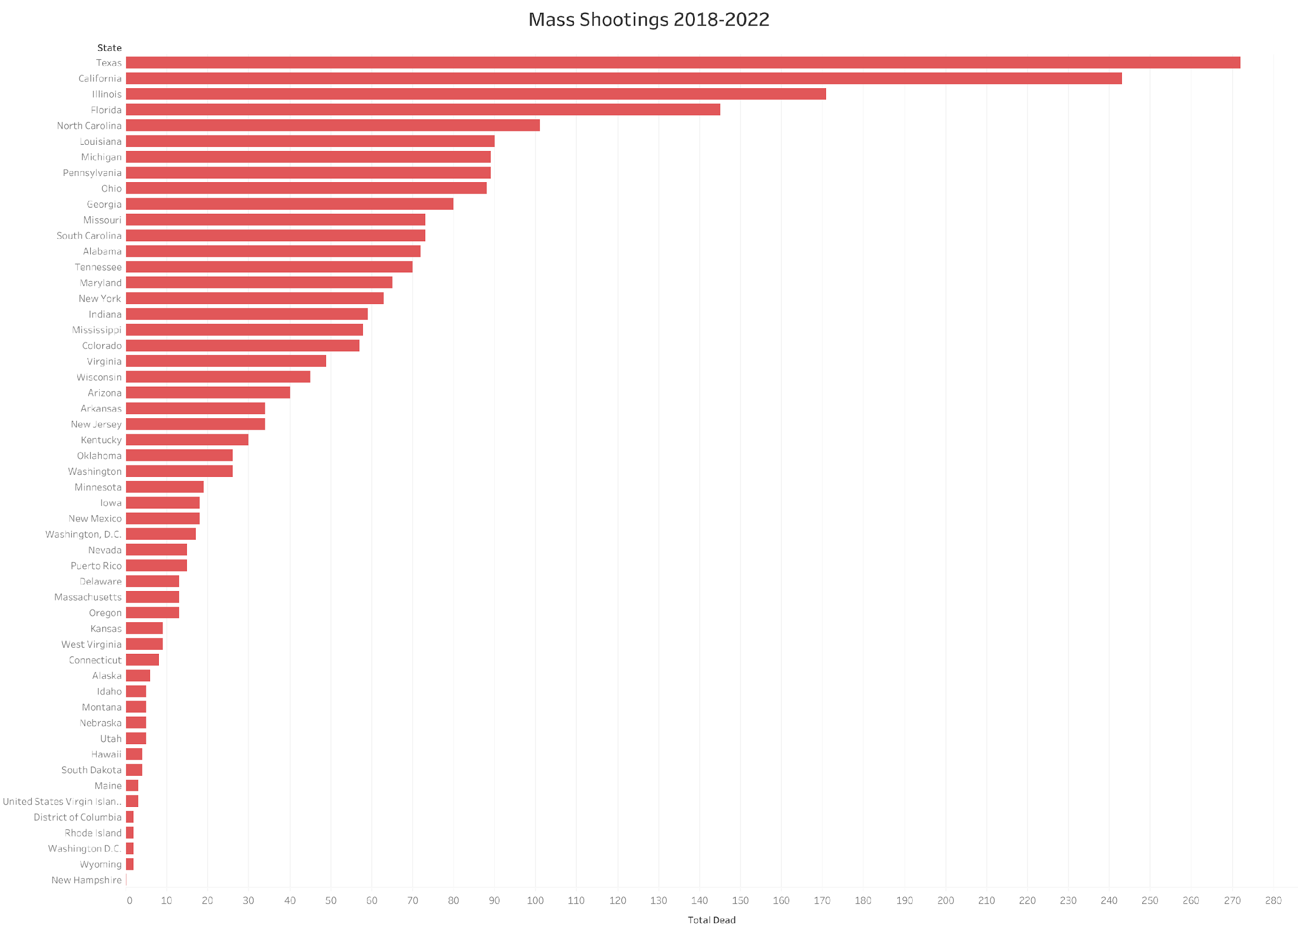

Slide 5
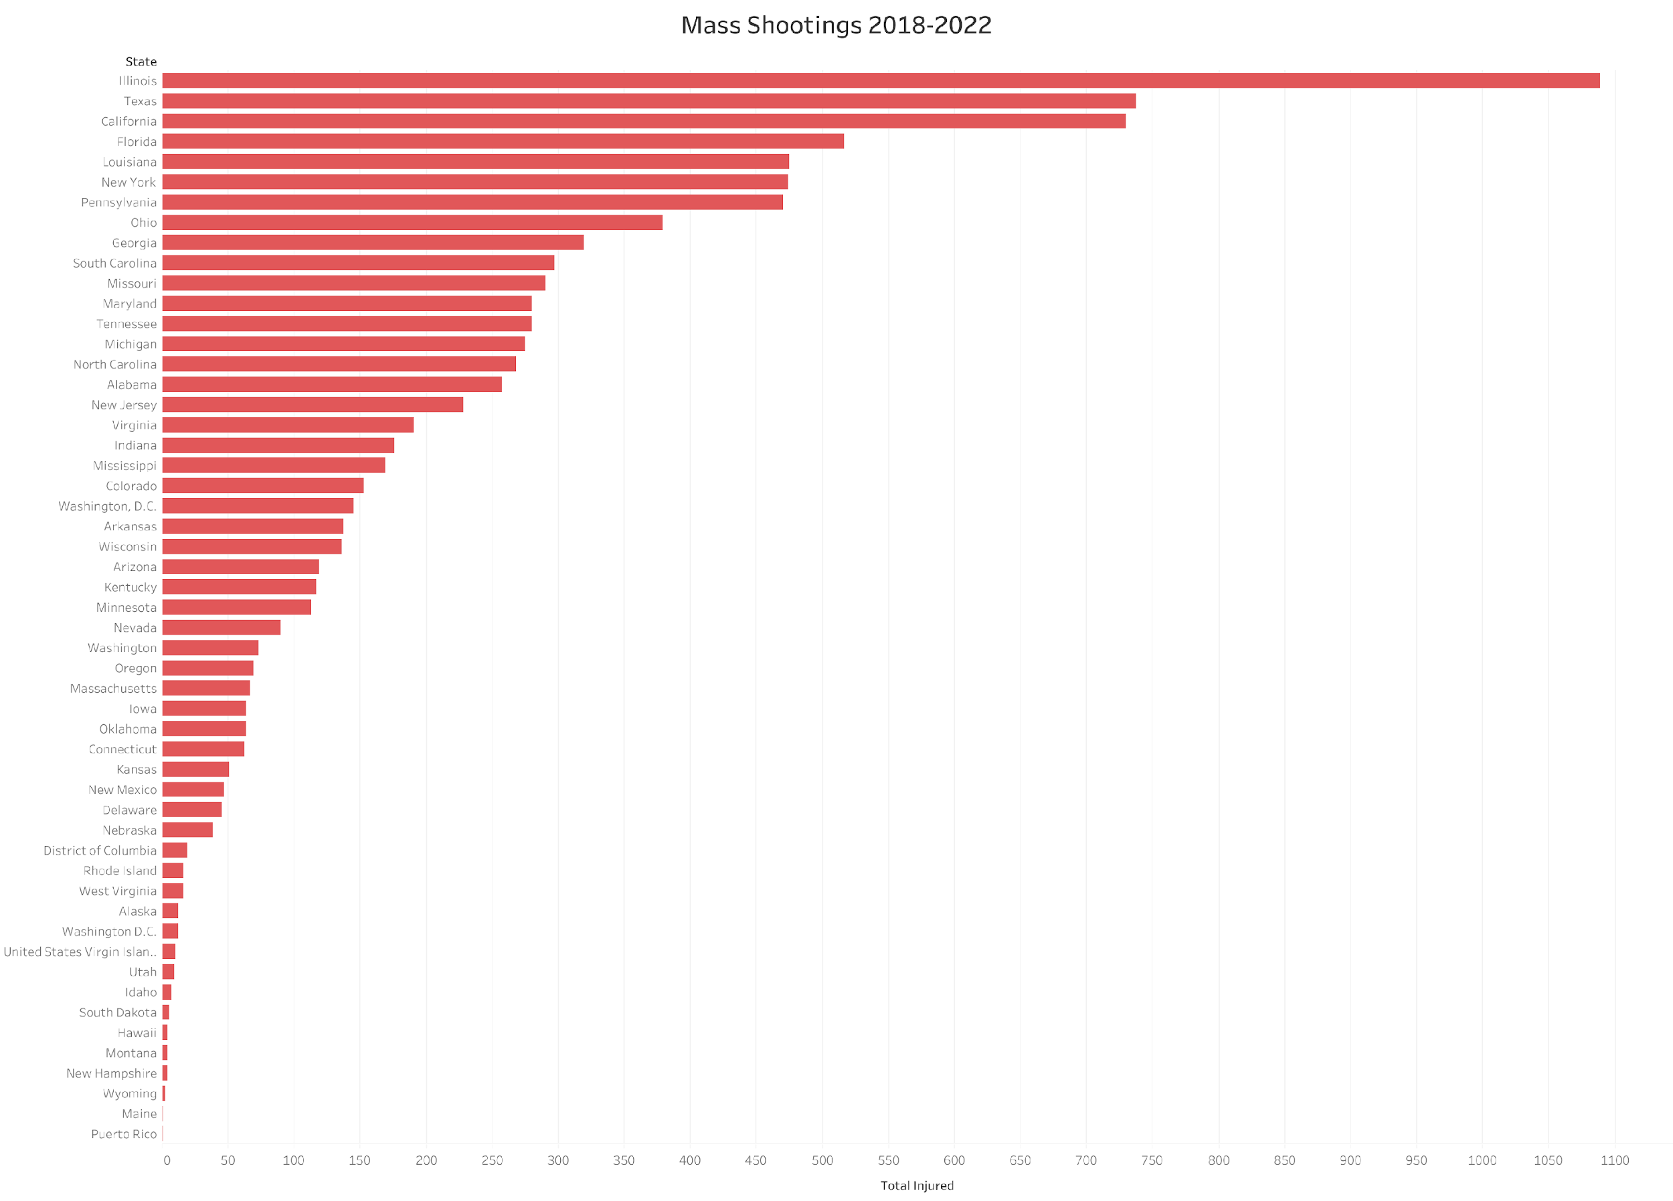

Slide 6
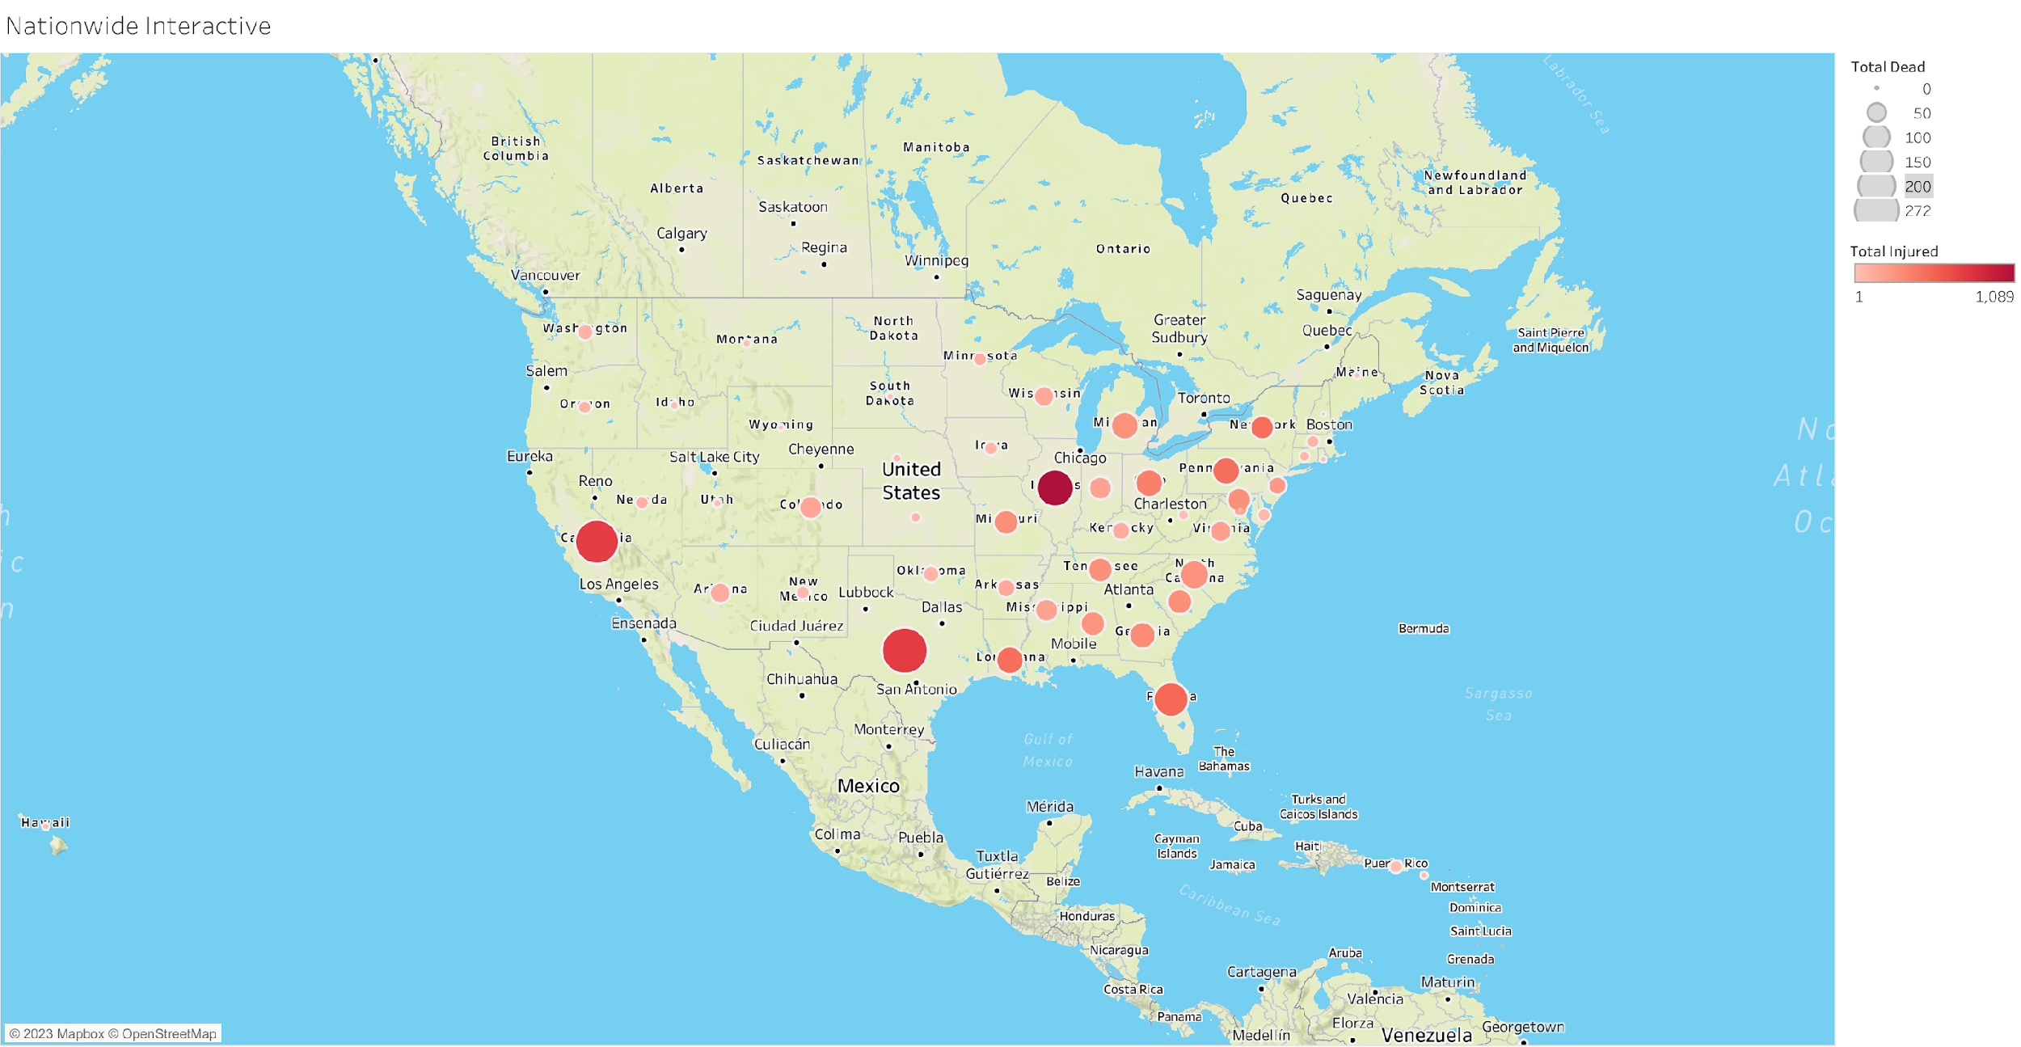

Slide 7
Findings:
The highest rate of mass shootings over a five year period, when combined with both deaths and injuries come from Illinois, a state with extremely strict gun laws.

Slide 8
Interpretation:
Based off the state where the most mass shootings come from, it seems that both the inept leadership in the state along with the promotion of criminal activity has caused this to happen, which in turn will lead to more people being afraid of living there day to day

Slide 9
Recommendations:
We recommend focusing all of our strength on getting the citizens of Illinois a chance to buy this course so they can help themselves stay saffer.

Slide 10
Limitations of Data:
The limitations of the data is the fact that it only shows the state as a whole and not the individual cities. Given a more specific breakdown we can do a better job at attracting the right customers for the course

Slide 11
Conclusion:
In conclusion, while it is an absolute tragedy that the amount of mass shootings are happening, it does create an opportunity to help to empower those who are caught in the crossfire to at minimum have a fighting chance at staying safe within their own homes

Slide 12
References:
https://www.kaggle.com/datasets/hemil26/mass-shootings-in-united-states-20182022
https://en.wikipedia.org/wiki/List_of_mass_shootings_in_the_United_States

